Slide 1
Uygulama-3
Dinamik Programlama

Slide 2
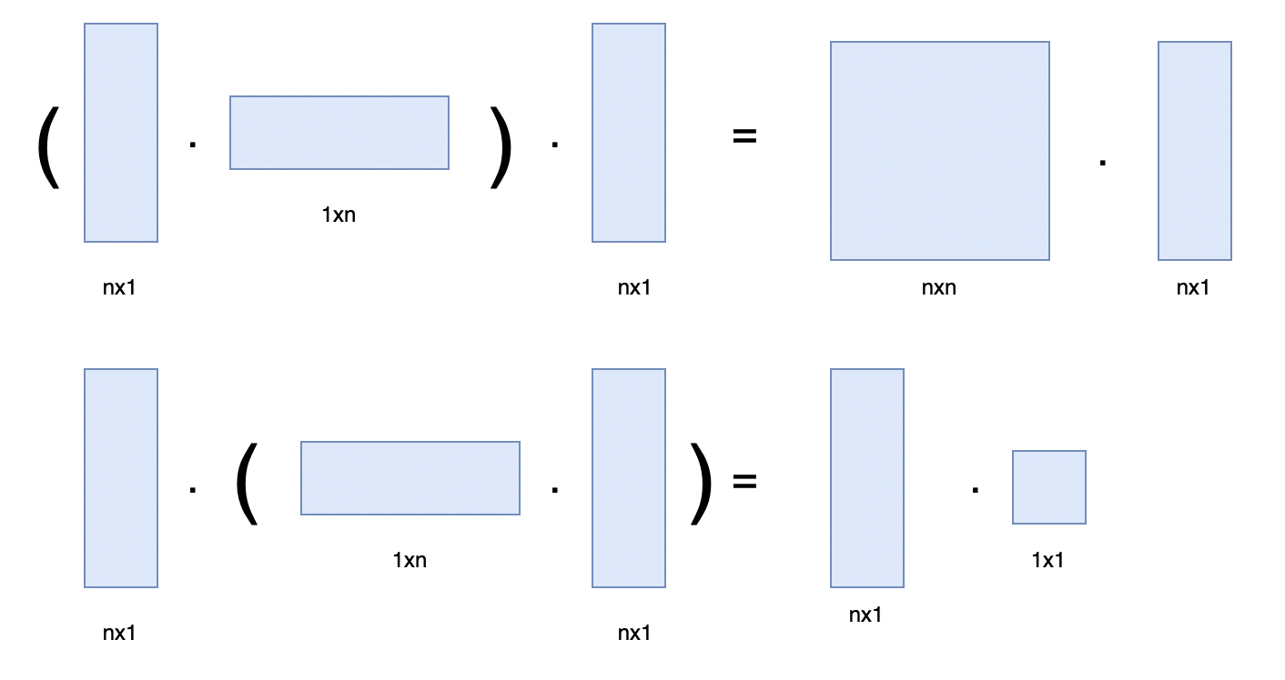
Matrix Chain Multiplication
Find the most efficient way to multiply matrices together such that the total number of element multiplications is minimum.

Slide 3
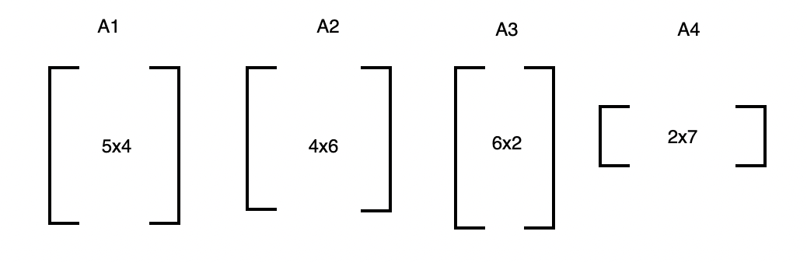

Slide 4
j
M[1,1] = 0
M[2,2] = 0
M[3,3] = 0
M[4,4] = 0
i
0 | 120
 | 0 | 48
 |  | 0 | 84
 |  |  | 0
M[1,2] = A1 * A2 = 5*4*6 = 120
M[2,3] = A2 * A3 = 4*6*2 = 48
M[3,4] = A3 * A4 = 6*2*7 = 84

Slide 5
j
i
0 | 120 | 88
 | 0 | 48
 |  | 0 | 84
 |  |  | 0
M[1,3] = A1 * A2 * A3
A1 * (A2 * A3) (A1*A2) * A3
A1 * (A2 * A3) = M[1,1] + M[2,3] + 5*4*2
= 0 + 48 + 40 = 88
(A1 * A2) * A3 = M[1,2] + M[3,3] + 5*6*2
= 120 + 0 + 60 = 180
0 | 1 | 1
 | 0 | 2
 |  | 0 | 3
 |  |  | 0

Slide 6
j
i
0 | 120 | 88
 | 0 | 48 | 104
 |  | 0 | 84
 |  |  | 0
M[2,4] = A2 * A3 * A4
A2 * (A3 * A4) = M[2,2] + M[3,4] + 4*6*7
= 0 + 84 + 168 =252
(A2 * A3) * A4 = M[2,3] + M[4,4] + 4*2*7
= 48 + 0 + 56 = 104
0 | 1 | 1
 | 0 | 2 | 3
 |  | 0 | 3
 |  |  | 0

Slide 7
j
M[1,4] = A1 * A2 * A3 * A4
min{M[1,1] + M[2,4] + 5*4*7 ,
M[1,2] + M[3,4] + 5*6*7 ,
M[1,3] + M[4,4] + 5*2*7
}
Min{244, 414, 158}
i
0 | 120 | 88 | 158
 | 0 | 48 | 104
 |  | 0 | 84
 |  |  | 0
M[i,j] = M[i,k] + M[k+1,j] + d_{i-1} * d_{k} * d_{j}
0 | 1 | 1 | 3
 | 0 | 2 | 3
 |  | 0 | 3
 |  |  | 0

Slide 8
0 | 1 | 1 | 3
 | 0 | 2 | 3
 |  | 0 | 3
 |  |  | 0
((A1) (A2 A3)) A4
Time Complexity: O(N³ ) Auxiliary Space: O(N²)

Slide 9
Activity Selection Problem – Weighted Interval Scheduling
Given N jobs where every job is represented by following three elements of it. 1) Start Time 2) Finish Time. 3) Weight representing Profit or Value Associated.
Find the maximum profit subset of jobs such that no two jobs in the subset overlap.

Slide 10
Consider the following 6 activities.
start[] = {1, 3, 0, 5, 8, 5}; finish[] = {2, 4, 6, 7, 9, 9};
The maximum set of activities that can be executed by a single machine/job is {1, 2, 4, 5}.

Slide 11
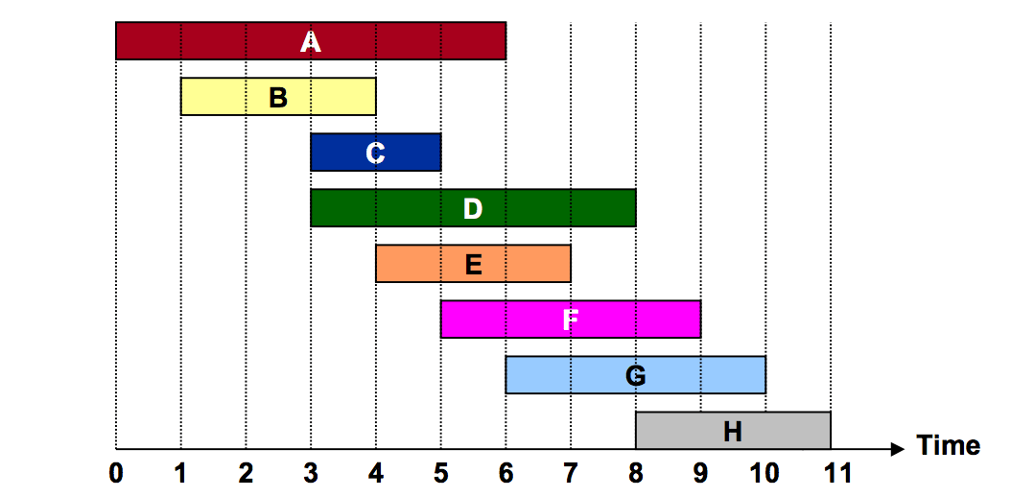
Job requests 1, 2, … , N.
Job j starts at sj, finishes at fj , and has weight wj .
Two jobs compatible if they don’t overlap.
Goal: find maximum weight subset of mutually compatible jobs.

Slide 12
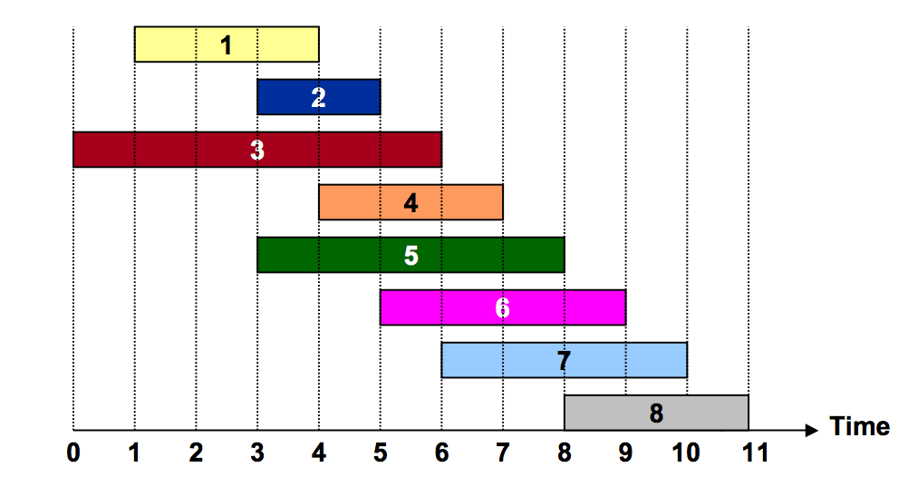
Let’s sort and label the jobs by finishing time:
4
5
2
1
8
4
8
3
Lets define qj = largest index i < j such that job i is compatible with j.. For example - q7 = 3, q2 = 0.

Slide 13
Max_Profit[0] = 0
Max_Profit[1] = max(Max_Profit[0], Max_Profit[q1] + w(1)
= max(0, 0 + 5) = 5
Max_Profit[2] = max(Max_Profit[1], Max_Profit[q2] + w(2)
= max(5, 0 + 2) = 5
Max_Profit[3] = max(Max_Profit[2], Max_Profit[q3] + w(3)
=max(5, 0 + 4) = 5
Max_Profit[4] = max(Max_Profit[3], Max_Profit[q4] + w(4)
= max(5, 5+8) = 13
Max_Profit[5] = max(Max_Profit[4], Max_Profit[q5] + w(5)
= max(13, 0 + 1) = 13
Max_Profit[6] = max(Max_Profit[5], Max_Profit[q6] + w(6)
= max(13, 5+4) = 13
Max_Profit[7] = max(Max_Profit[6], Max_Profit[q7] + w(7)
= max(13, 5+8) = 13
Max_Profit[8] = max(Max_Profit[7], Max_Profit[q8] + w(8)
= max(13, 13+3) = 16
j | w(j) | q(j) | Max_Profit
0 | - | - | 0
1 | 5 | 0 | 5
2 | 2 | 0 | 5
3 | 4 | 0 | 5
4 | 8 | 1 | 13
5 | 1 | 0 | 13
6 | 4 | 2 | 13
7 | 8 | 3 | 13
8 | 3 | 5 | 16

Slide 14
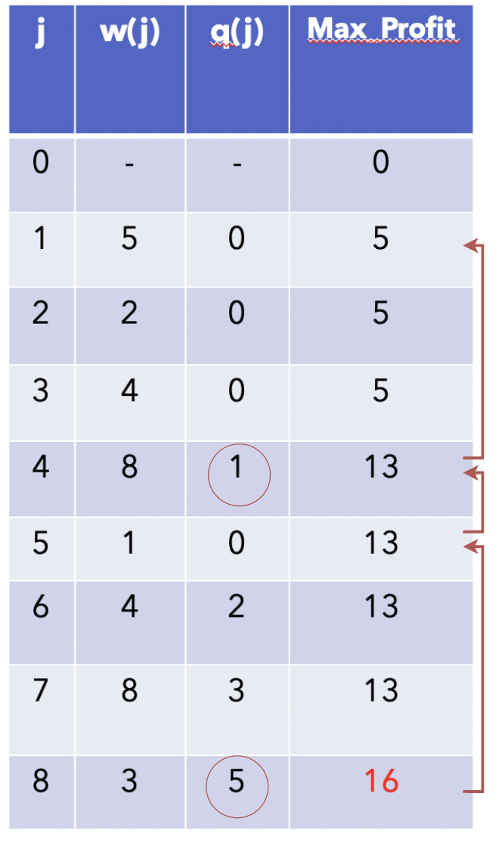
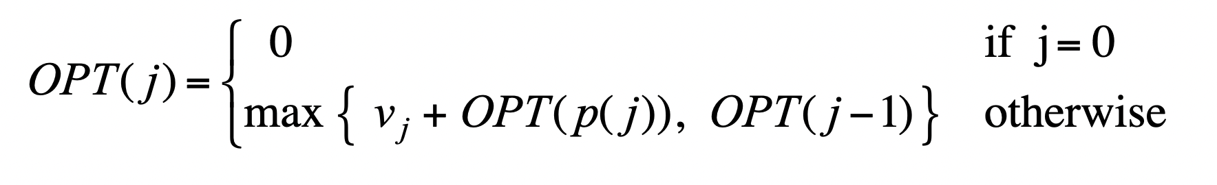
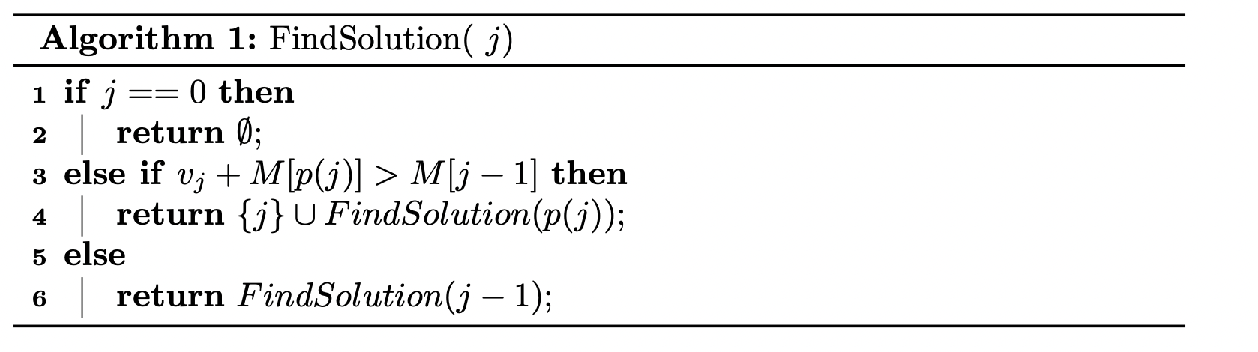
Max profit: 16
Solution: 8, 4, 1

